Slide 1

Trends Analysis
Hariprabhaa Murugesan

Slide 2
Introduction
YouTube is the world-famous online video-sharing platform.
Maintains a list of the top trending videos.
Valuable insights can be drawn through analysis.

Slide 3
Data Description
Video Id
Trending Date
Title
Channel Title
Category Id
Publish Time
Tags
Views
Likes
Dislikes
Comment Count
Thumbnail Link
Comments Disabled
Ratings Disabled
Video error or Removed
Description
Category

Slide 4
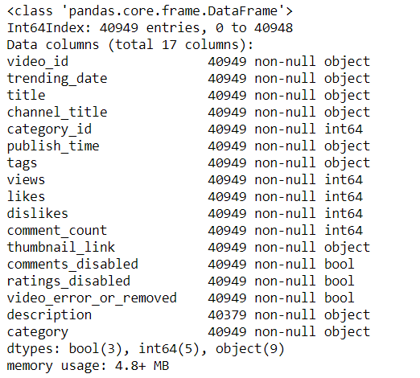
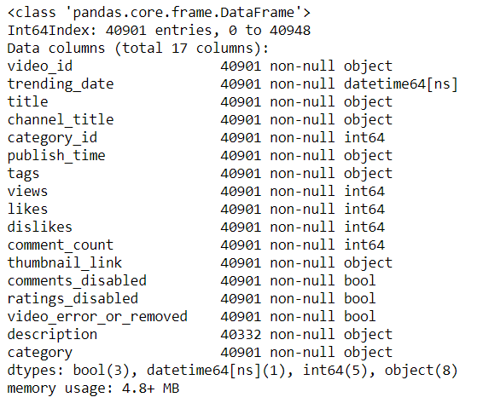
Data cleaning
Data Type Conversion
Remove Null values
Remove Duplicate values

Slide 5
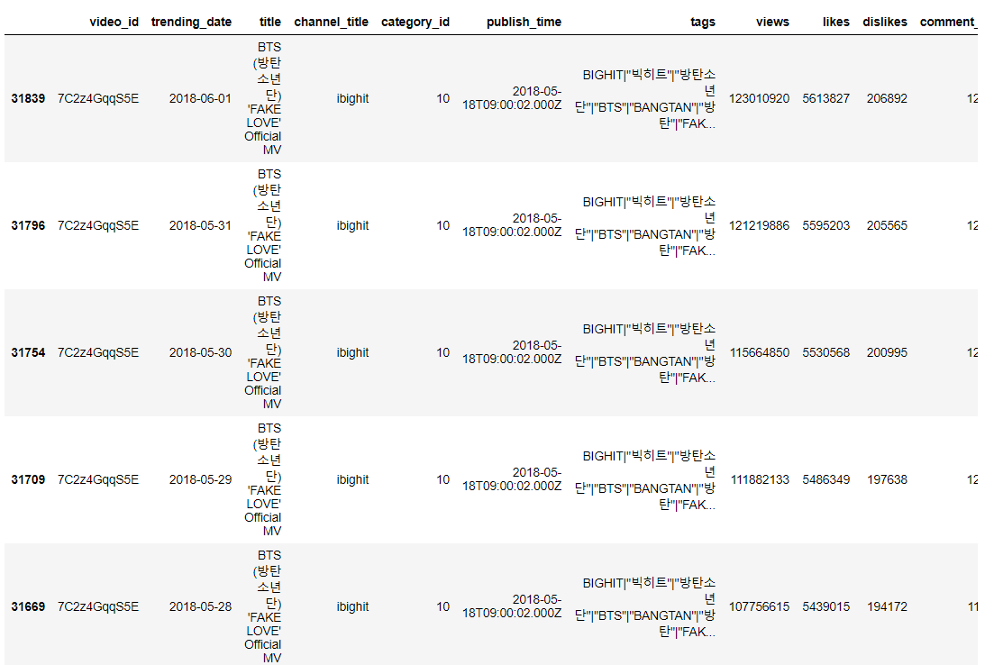
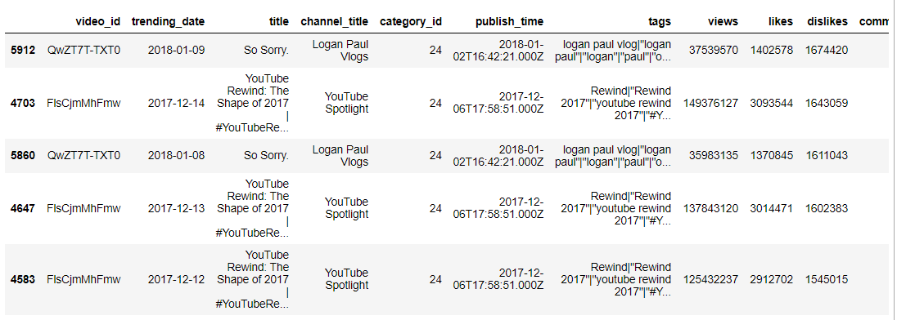
Most Liked & Disliked Videos

Slide 6
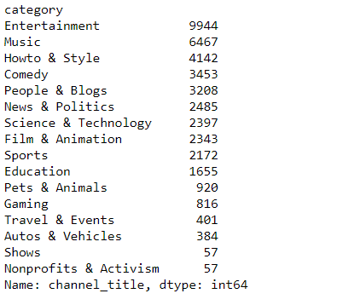
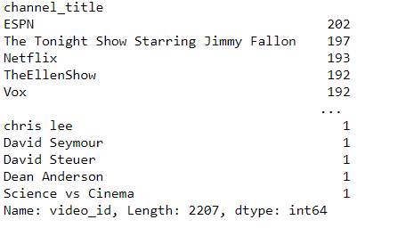
No. of You Tube Channels

Slide 7
Visualizations

Slide 8
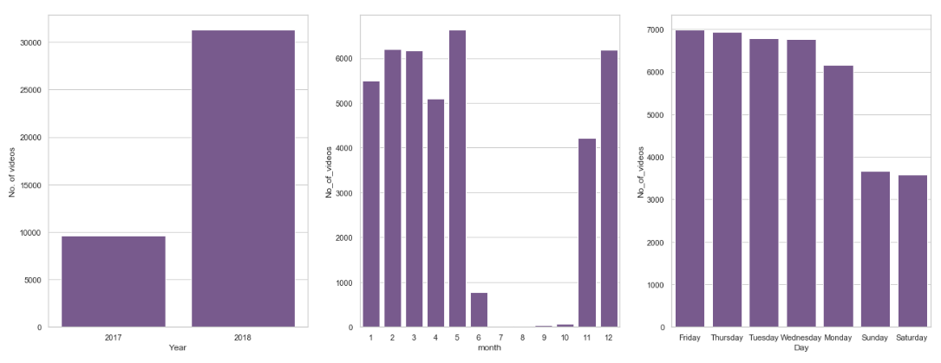
Analysis by Published Time

Slide 9
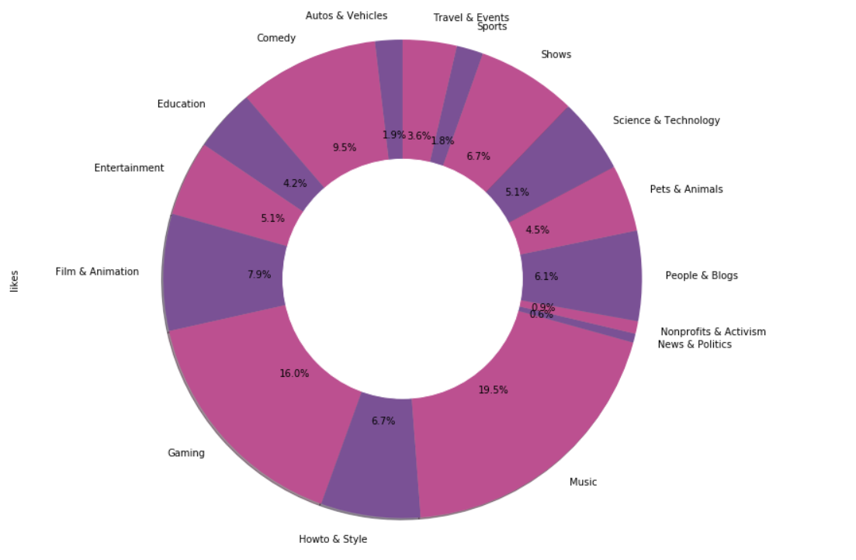
Analysis by Category

Slide 10
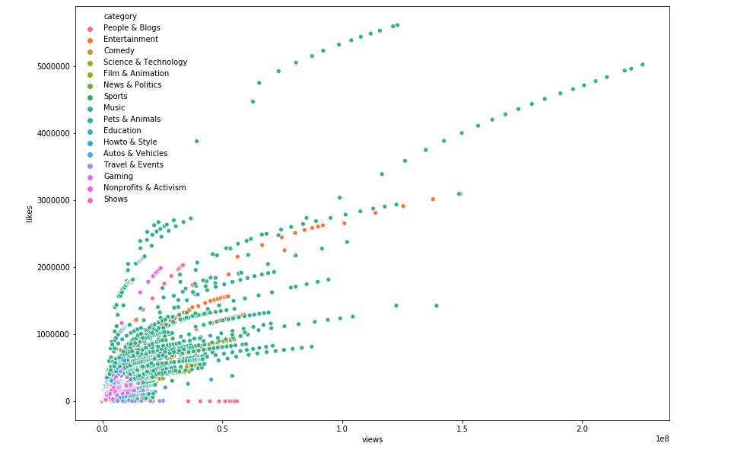
Views Vs Likes

Slide 11
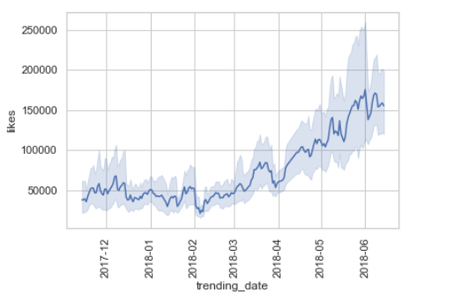
Likes by Trending Date

Slide 12
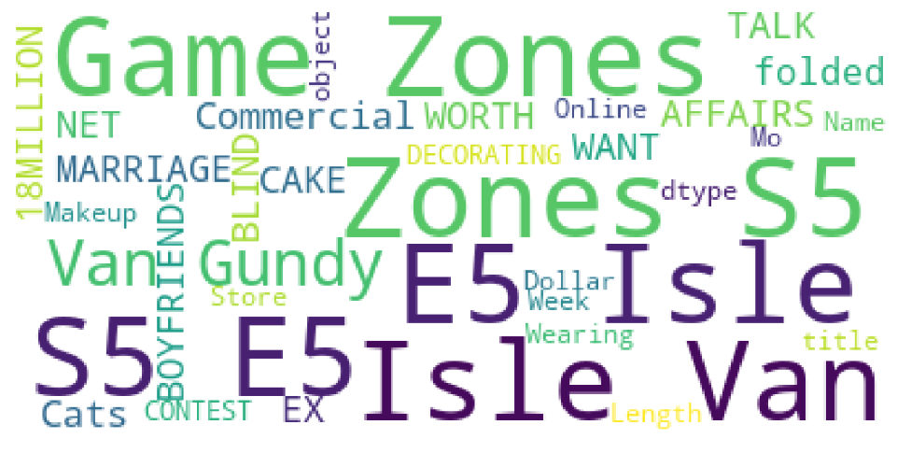
Trending Words

Slide 13
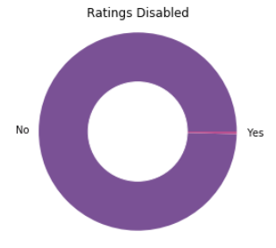
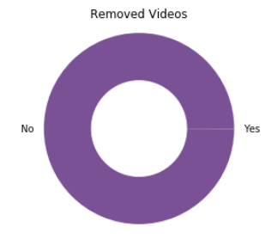
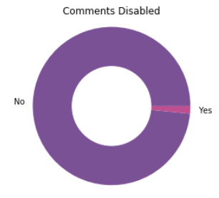
Boolean Variables Analysis

Slide 14
Conclusion
Music and Gaming genre videos tops the list followed by Comedy, Film & Animation.
Friday seems to be the best day to publish videos.
Tags contributes more towards the views count.
ESPN manages to be in top and Ellen Show gets more attention.

